Slide 2
WHY
Children’s mental health
is far to simple and far to complicated for one discipline
AU researchers
have strong competences within this field
have established strong research environments
have a close contact with the Danish professional environments
have strong international collaborations

Slide 3
WHO
ARTS
DPU (Karen Wistoft, Ole Henrik Hansen, Søren Langager)
BSS
Economics (Michael Rosholm, Camilla Gumede, Mette Verner, Nabanita Gubta)
Psychology (Mikael Thastum)
SciTech
Computerscience (Kaj Grønbæk)
Health
Neuroimaging (Morten Kringelbach)
Genetics (Anders Børglum)
Epidemiology (Jørn Olsen, Jiong Li)
Biostatistics (Erik Parner)
General medicine (Carsten Obel, Jin Liang Zhu)
Comittee of Health information (Charan Nelander, Poul Lundgaard Bak)

Slide 4
HOW

Slide 5
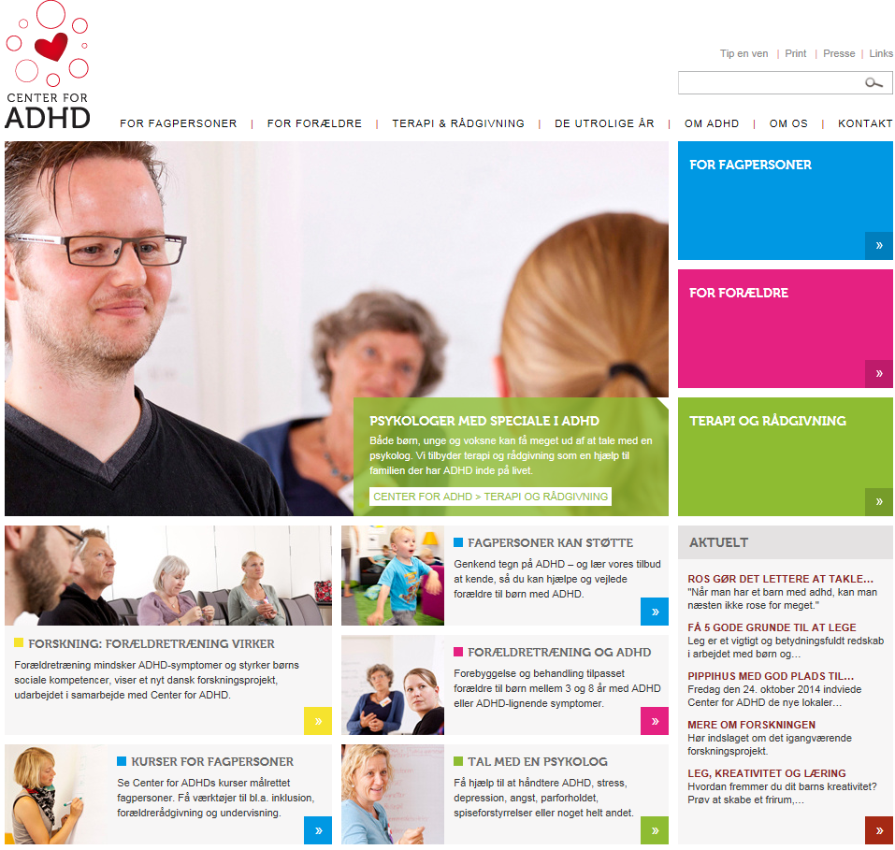
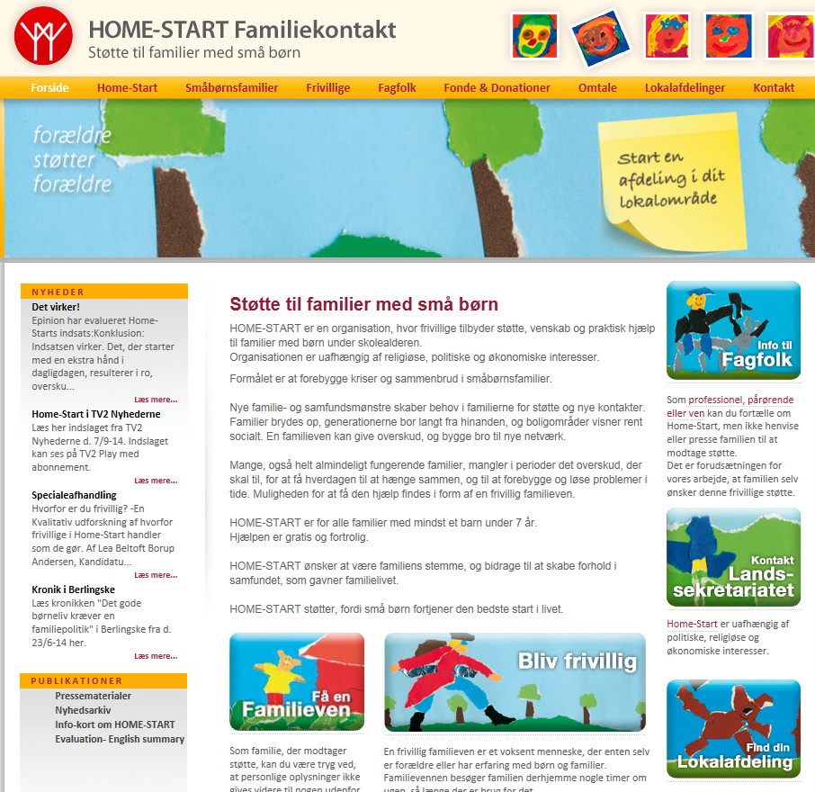
‘WHOM

Slide 6
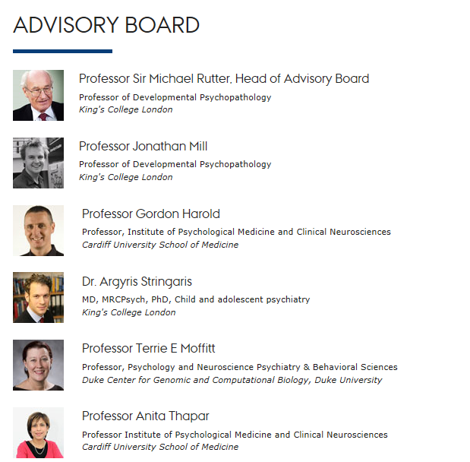
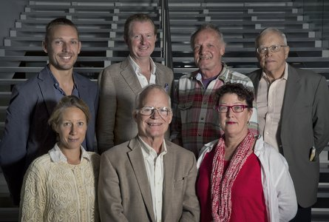
‘WHOM

Slide 7
WHAT
AU collaboration groups
Datainfrastructure (registers and cohorts)
Methodology (family designs, interventions)
Collaboration with municipalities
Developing measures of mental health
?
Post doc driven

Slide 8
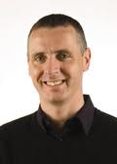
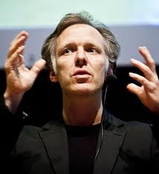
WHAT
National/international workshops
Family relationships influences on Children’s Psychopathology (Gordon Harrold, Sussex, UK)
Understanding the human parental brain (Morten Kringelbach, Oxford, UK)
Homo digitalis- social media mental health (Natasha Saxberg Friis, NY, USA)

Slide 9
WE CAN

Slide 10
WE CAN

Slide 11
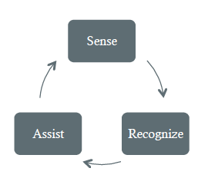
Physiological computing
”Systems that employ real-time measures of psychophysiology to communicate the psychological state of the user to an adaptive system”
Stephen H. Fairclough (2009). Fundamentals of physiological computing. Interacting with Computers vol. 21 (2009) 133–145. Elsevier, NL.

