Slide 1

A systematic approach to support children’s mental health
Carsten Obel
Program for Mental Child Health, Institute of Public Health, AU iupgrowth.au.dk
The Health information Comittee, sundhedsoplysning.dk

Slide 2
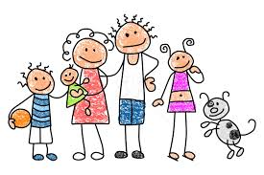




Children’s well being
Family
Class
Peers

Slide 3


Web reporting
Health nurse
Family
Class
Peers

Slide 4
Web reporting
Health nurse
Family
Class
Peers

Slide 6
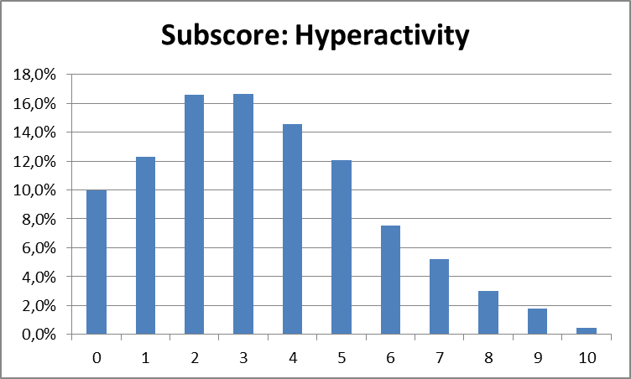
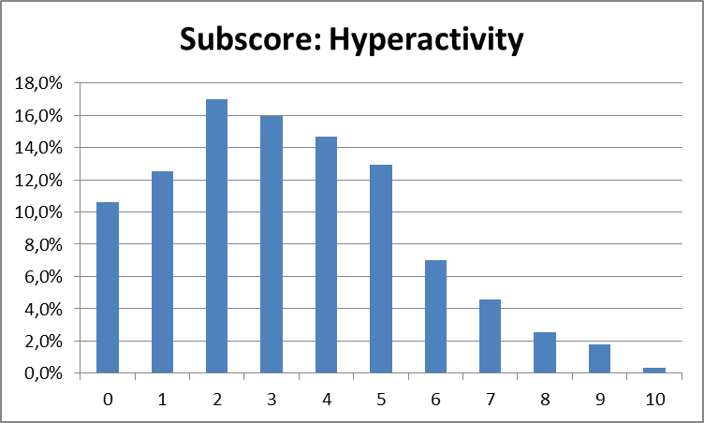
Girls and boys age 13-16 years

Slide 7
Children’s well being
Family
Class
Peers

Slide 8
Children’s well being
Abcense from school
Family
Class
Peers

Slide 9


Skolesundhedplus.dk
Abcense from school
Abused children
?
Foster care children
Children of divorced
Social services
School psychologists
DUBO
Child psychiatry
ADHD-RS
IQ test

Slide 10
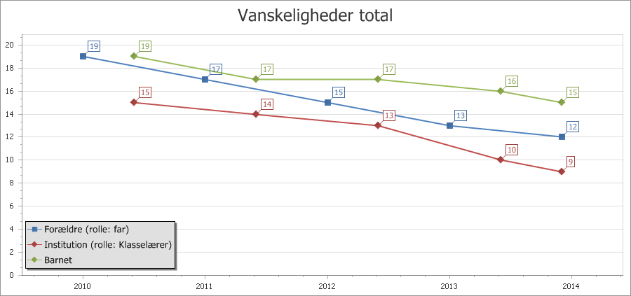
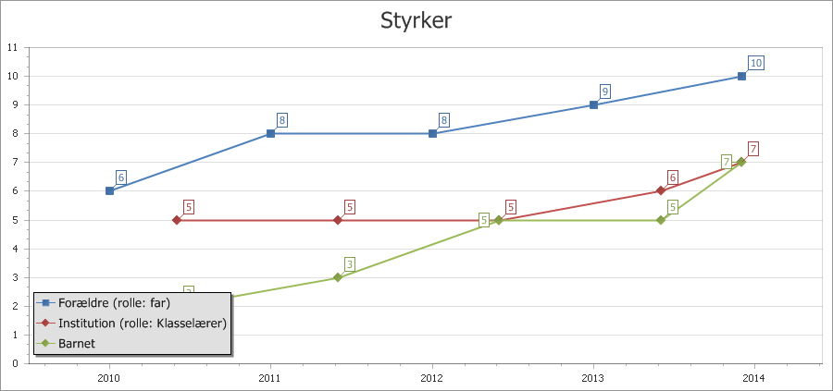
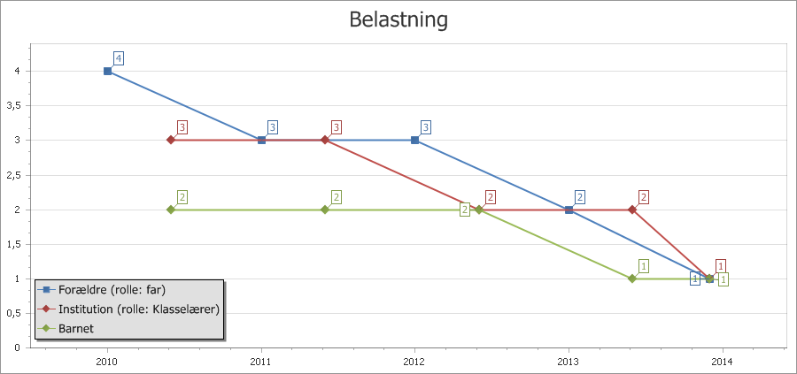
SDQ
Core measure of mental health in children
  Shared care
  Shared follow-up
High sensitivity
Provides a hint of specific mental and relation problems
Stress temperature?

Slide 11
DAWBA
Ruling out problem’s contributions
  Psychiatric
  Family
  School
Free (municipalitis)
Can rule out psychiatry fast

Slide 12
Developmental plan
Collaboration with municipalities as natural experimental resources
Mapping effects
Randomized trails
Development of skolesundhedplus.dk
Personalized support
Sensor based tracking

Slide 13
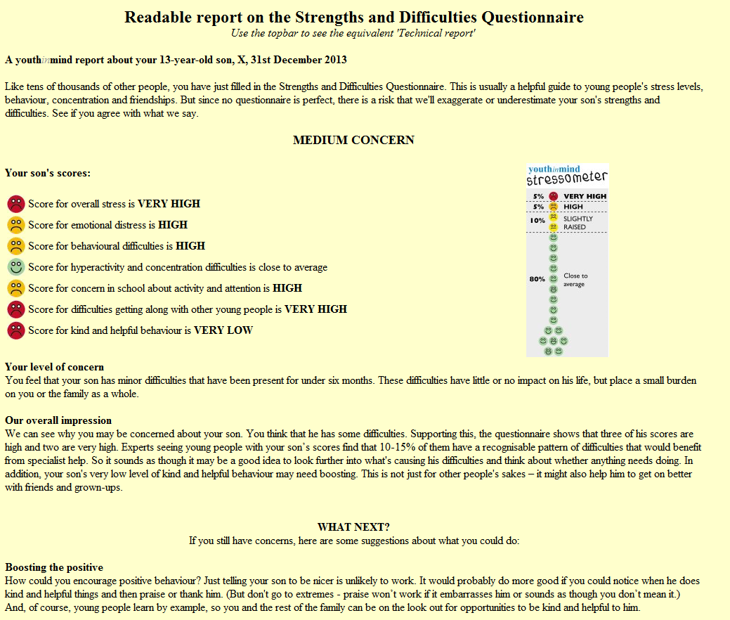
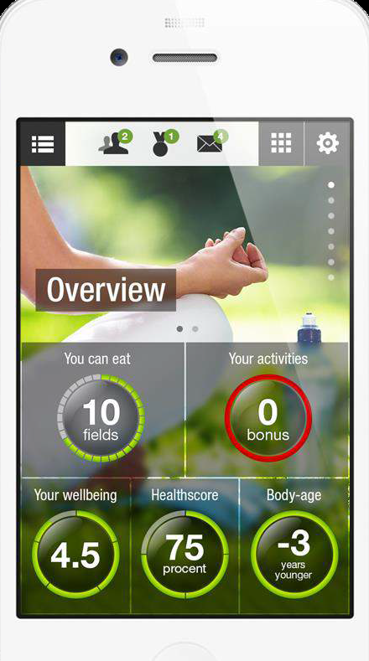
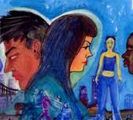
Personalized support

